Slide 1
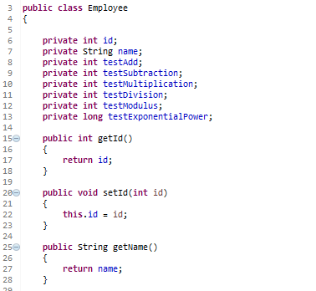
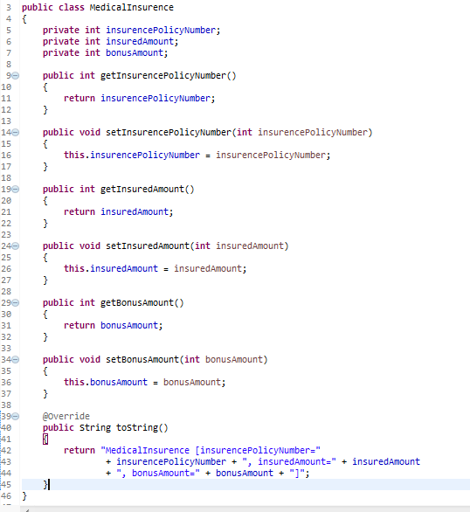

Spring Mathematical operators
…
…

Slide 2
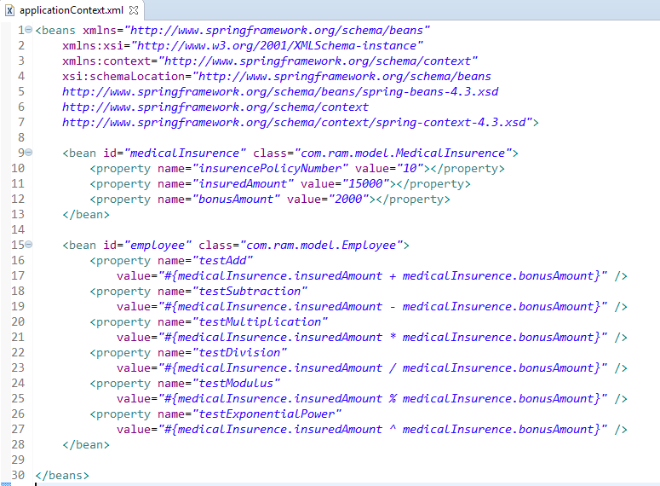
Mathematical operators – addition (+), Subtraction (-), Multiplication (*), division (/), modulus (%) and exponential power (^).

Slide 3
